Slide 1

Sub Advisor Questionnaire – SAQ
2011 Release
Presented by
AMAS L3 Team

Slide 2
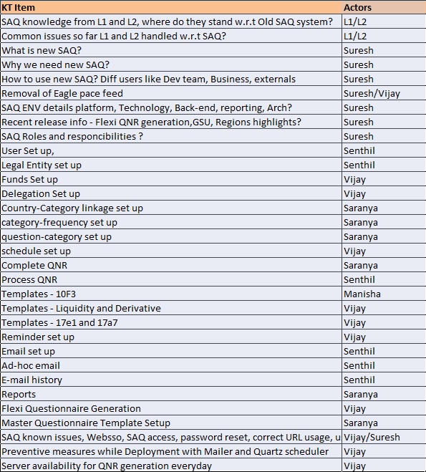
Agenda

Slide 3
Category Setup
Questions in the SAQ system are grouped together into categories. The Global super user/regional super user can create as many categories as needed for a questionnaire.
In the current system, Categories are common for all the schedules (Monthly/Quarterly/Annual) and can be mapped to a particular schedule, group and country in category country linkage setup.
Actions in category setup:
1.Adding category
2.Modify Category
3.Inactivate Category
To review the categories that is setup in the system,
Click on the Category link located under Setup Questionnaire from the left menu.
This will bring up the appropriate Category Review screen showing all active categories. The number of questions linked to each category will also be displayed. Each record will be displayed with an Inactivate and Update link in the Action column.
To add a new category,
Click on the Category link located under Setup Questionnaire from the left menu to bring up the appropriate Category Review screen.
Click on the Add Category link to bring up the Category Add screen.

Slide 4
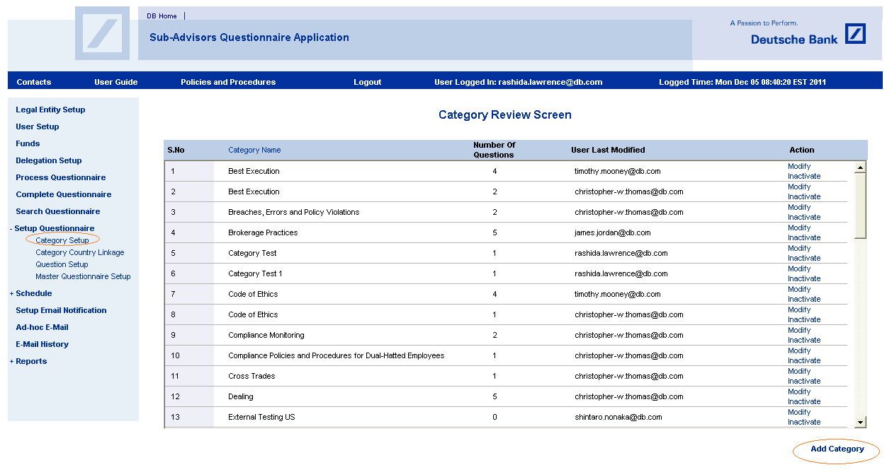
Category Setup (Contd.)

Slide 5
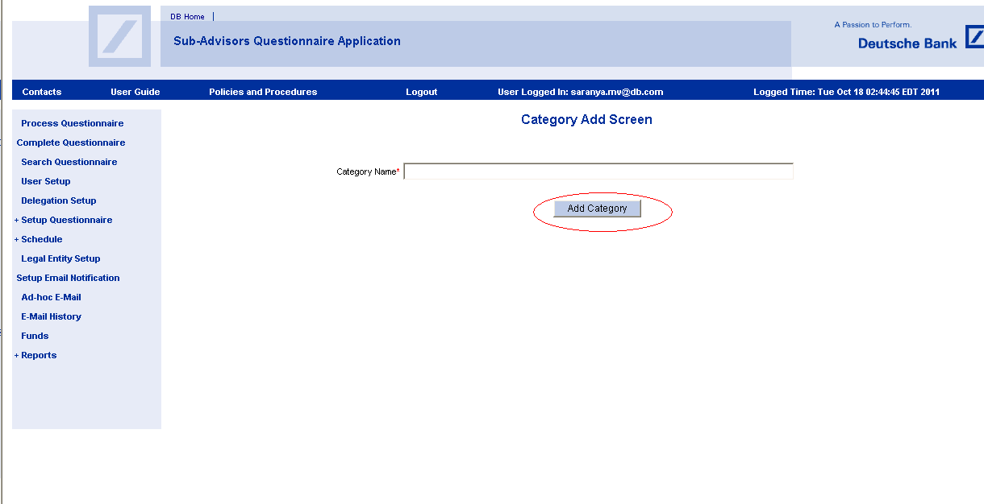
Category Setup (Contd.)
Enter the description of the category and click Add Category
The category will be added and the user will be taken back to the Category Review screen where the new category will be displayed.

Slide 6
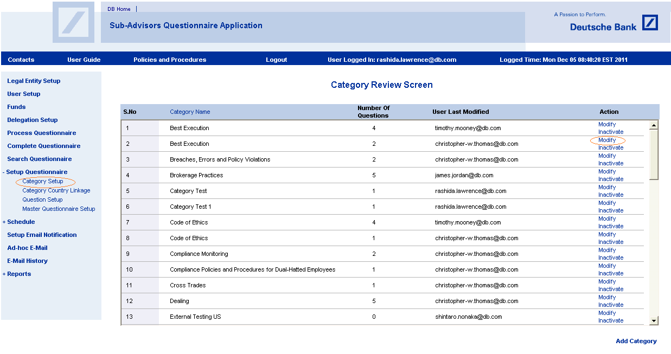
Update Category
To update the description for a specific category,
Click on the Update link in the Action column

Slide 7
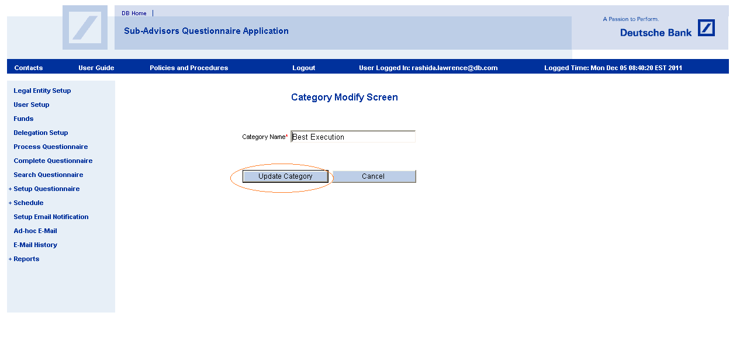
Update Category (Contd.)
This will bring up the Category Update screen
Enter the updated description
Click the Update Category button
The changes will be saved and the user will be taken back to the Category Review screen where the updates will be displayed.

Slide 8
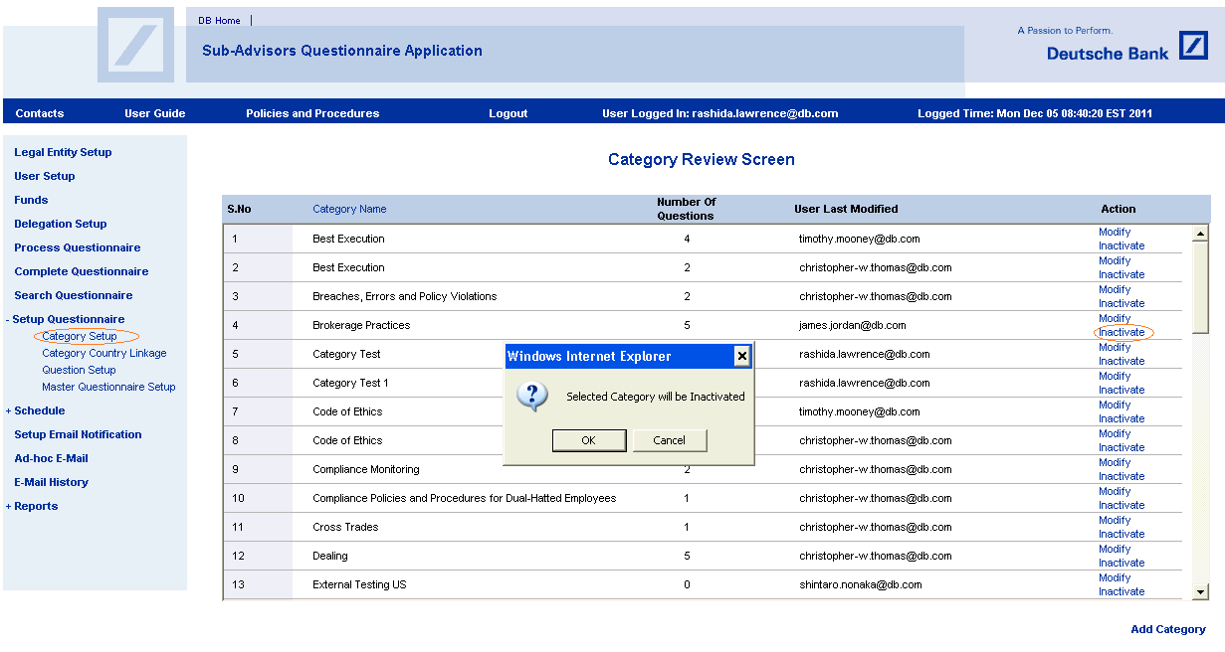
Inactivating Category
To inactivate a category that is no longer needed,
Click the Inactivate link in the Action column alert message Selected category will be inactivated will be displayed.
Click OK to proceed with removing the category or Cancel to abort the action
Categories that are inactivated will not be displayed on the screen; however, the records will still be kept in the system.
Approved/process Questionnaires has no impact after inactivating the category and changes are automatically shown up for Draft questionnaire.

Slide 9
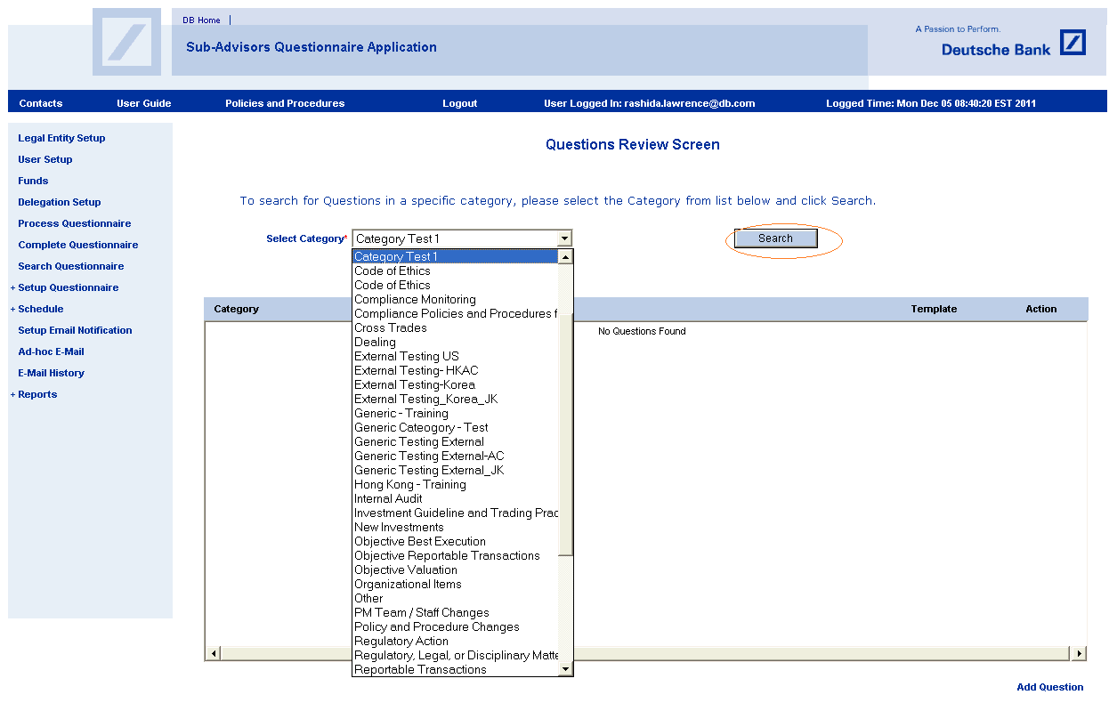
Mapping questions to a category
Questions should be added to a category before setting up the Questionnaire template.
To review the questions which are setup in the system,
Click on the Question link located under Setup Questionnaire from the left menu.
Select the category name from the pick list and click the Search button.

Slide 10
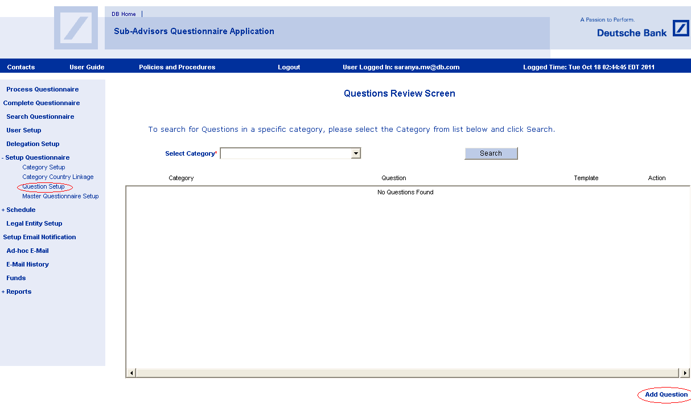
Mapping questions to a category (Contd.)
This will bring up the appropriate Questions Review screen showing all active questions.
Each record will be displayed with an Inactivate, Update and Clone link in the Action column and the “Add Question” link located at the right bottom of the page.
Click on the Add Question link to bring up the Add Question screen.

Slide 11
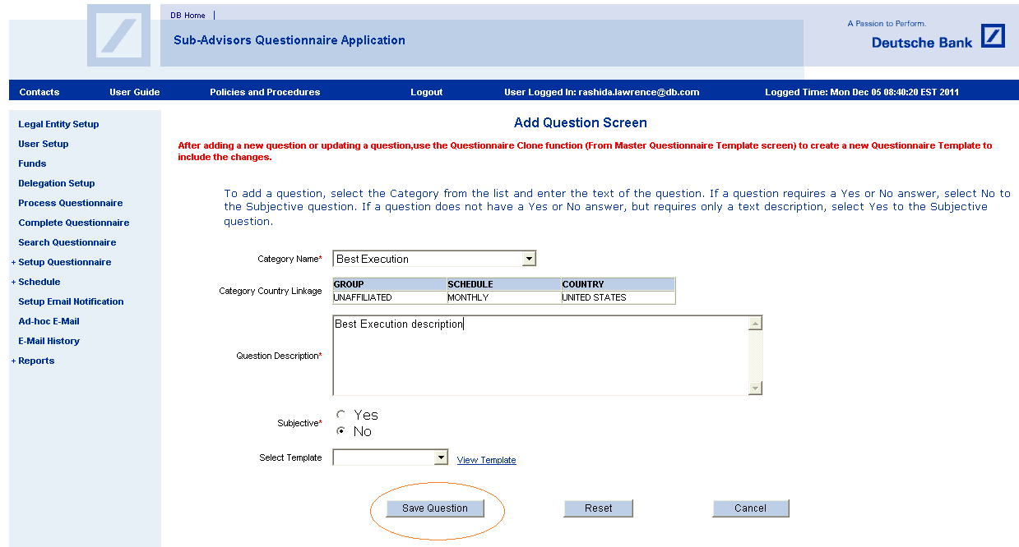
Mapping questions to a category (Contd.)
Select the Category from the list and enter the text of the question
Group, Schedule and Country mapped to the particular Category is displayed below the category with the label Category Country Linkage.
If a question requires a Yes or No answer, select No to the Subjective question.
If a question does not have a Yes or No answer, but requires only a text description, select Yes to the Subjective question.
The user has the option of viewing fields on the pre-defined template by clicking on the View Template link.
Click on Save Question to save the question and return to the Question Review screen.

Slide 12
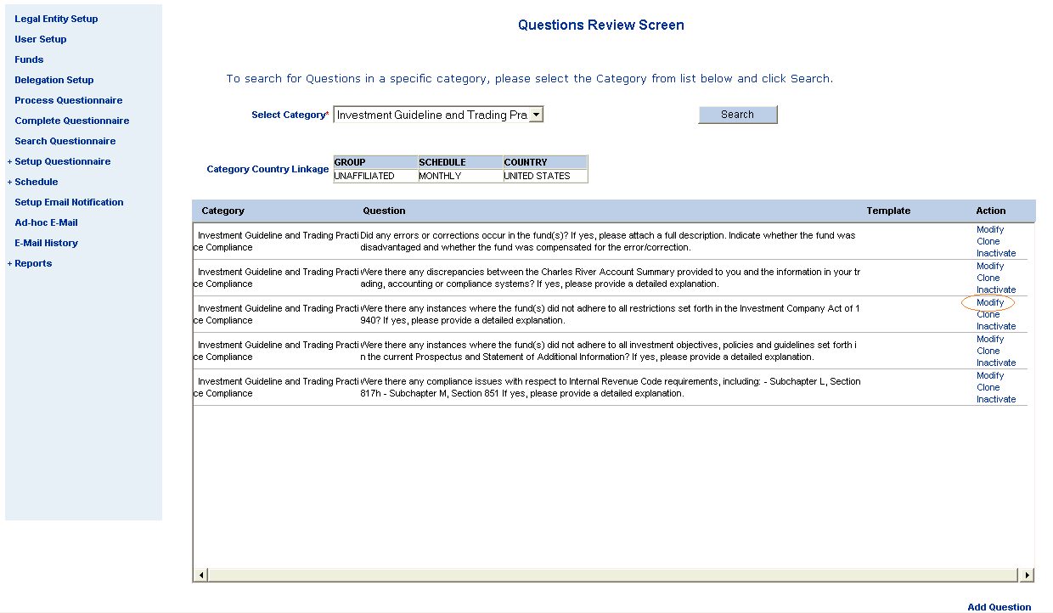
Modifying Questions
To modify the Questions in the Question setup,
click on modify link under the action column.

Slide 13
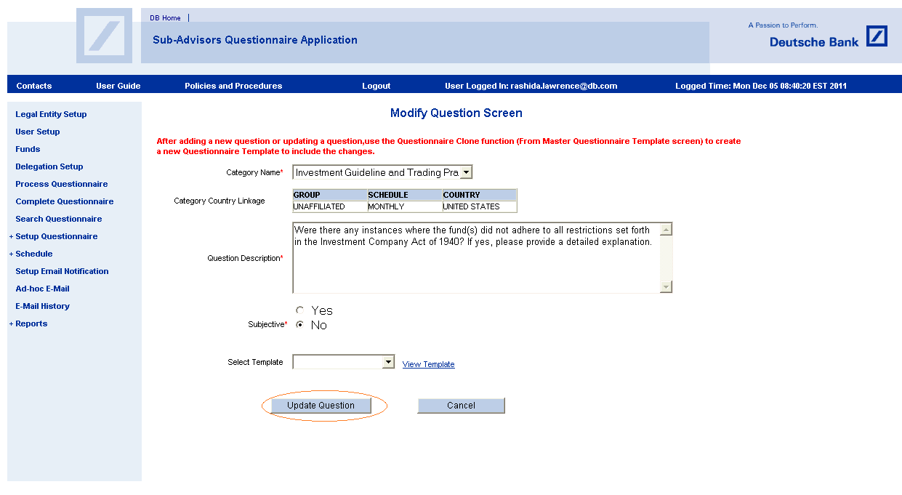
Modifying Questions (Contd.)
All fields on this screen are editable.
Enter the updated description
Click the Update Question button
The changes will be saved and the user will be taken back to the Question Review screen where the updates will be displayed

Slide 14
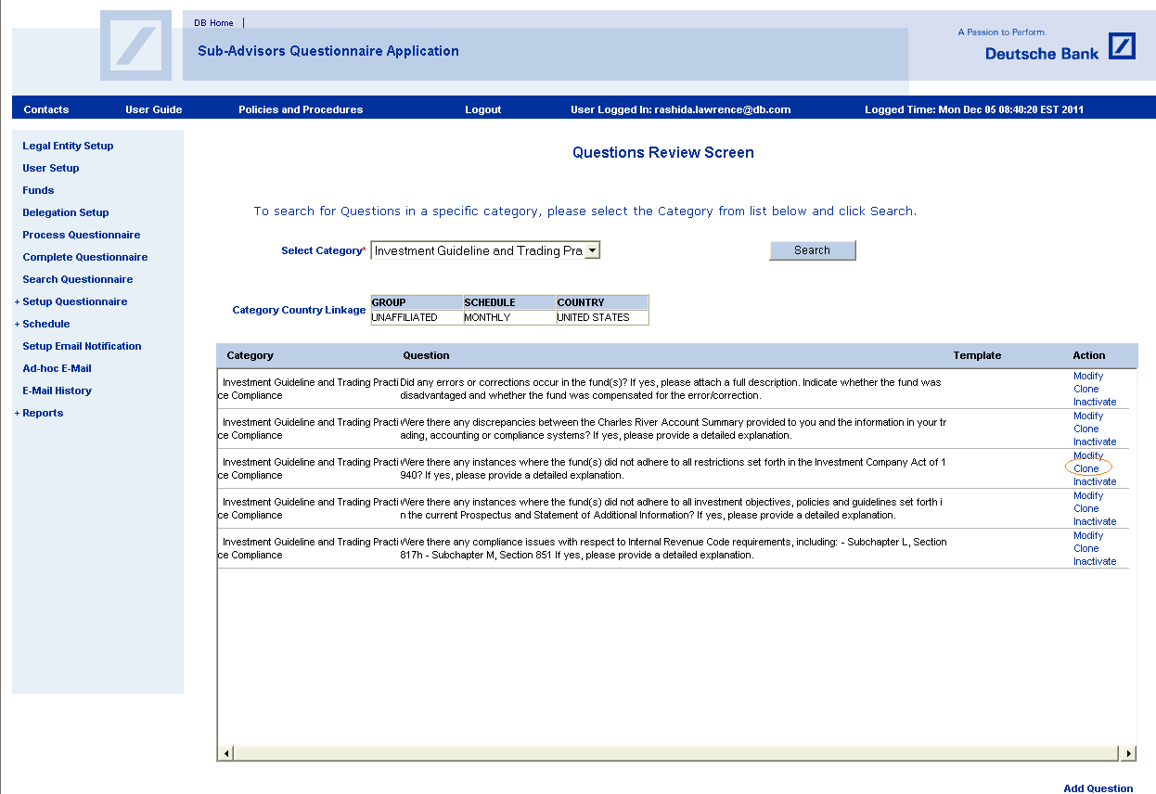
Cloning Questions
To clone a question,
Scroll to the record that needs to be cloned
Click the Clone link in the Action column

Slide 15
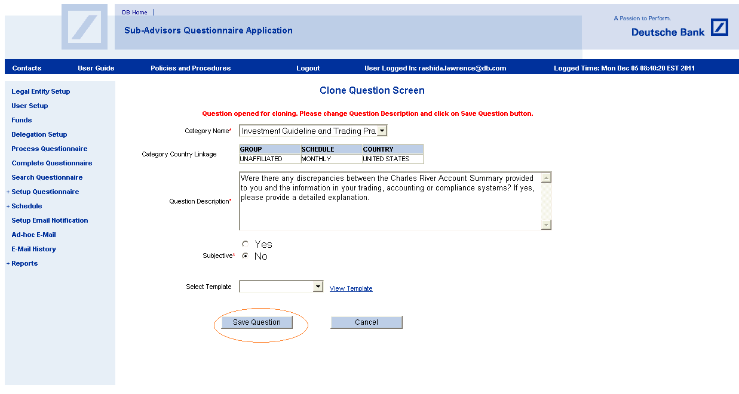
Cloning Questions (Contd.)
All fields on this screen are editable.
Enter the updated description
Click the Save Question button
Notes:
In the new SAQ system,
we added 2 new fields - Security Id (M) and ISIN (O)
CUSIP, Ticker made as optional fields
Sub-Advisor group is removed
Sub-Advisor Name is renamed as Legal Entity and the corresponding dropdown will have all UNAFFILIATED legal entities

Slide 16
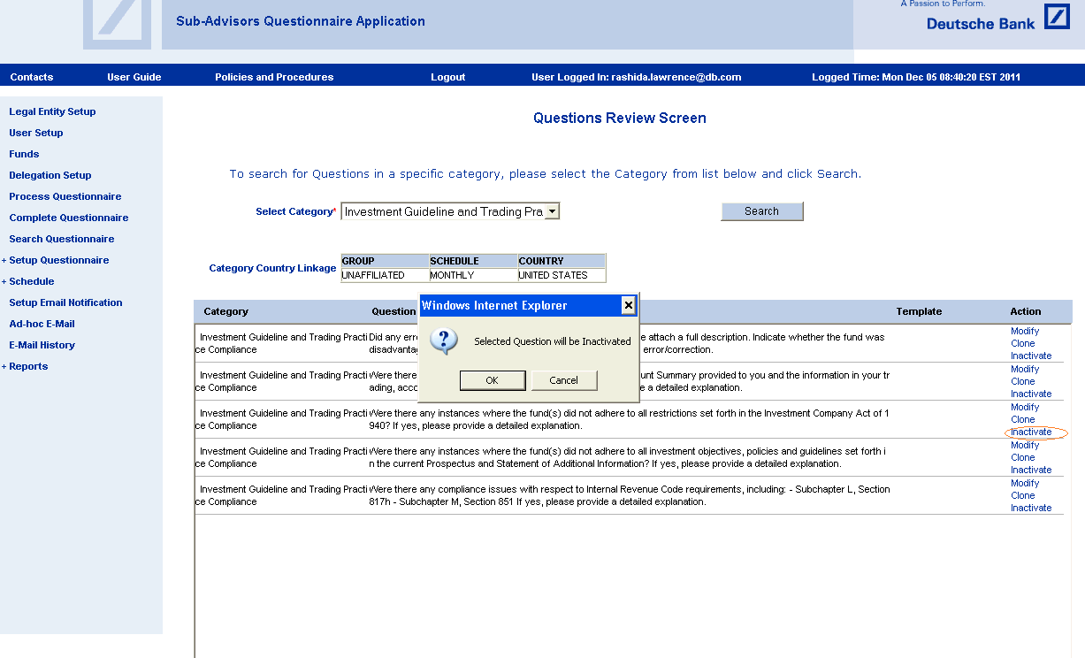
Inactivating questions
To inactivate a question that is no longer needed
Scroll to the record that needs to be inactivated
Click the Inactivate link in the Action column
Click OK to proceed with removing the question or Cancel to abort the action
Questions that are inactivated will not be displayed on the screen; however, the records will still be kept in the system.
Notes:
Fund information will be used in delegation setup module for UNAFFILIATED relationships for mapping funds
Criteria for display - Funds are only for UNAFFILIATED (To Legal Contracting Entity)

Slide 17
Category Country Linkage
In the new process, a new mapping screen will be created to map pre defined categories to Country and Frequency. This mapping will be used during creation of questionnaires templates.
On clicking the link ‘Country Linkage Setup’ user can see the list of category country linkage,
The list will display all the category country linkage.
Frequency column displays whether it’s Annual/Monthly/Quarterly.
Country displays Generic/Specific countries.
Type as Affiliated and Unaffiliated.
Action column for user modification or deletion.
Add country linkage link to add additional mappings/relations.
Click on the Add Category Country Linkage link map category to a country.
Notes:
Fund information will be used in delegation setup module for UNAFFILIATED relationships for mapping funds
Criteria for display - Funds are only for UNAFFILIATED (To Legal Contracting Entity)

Slide 18
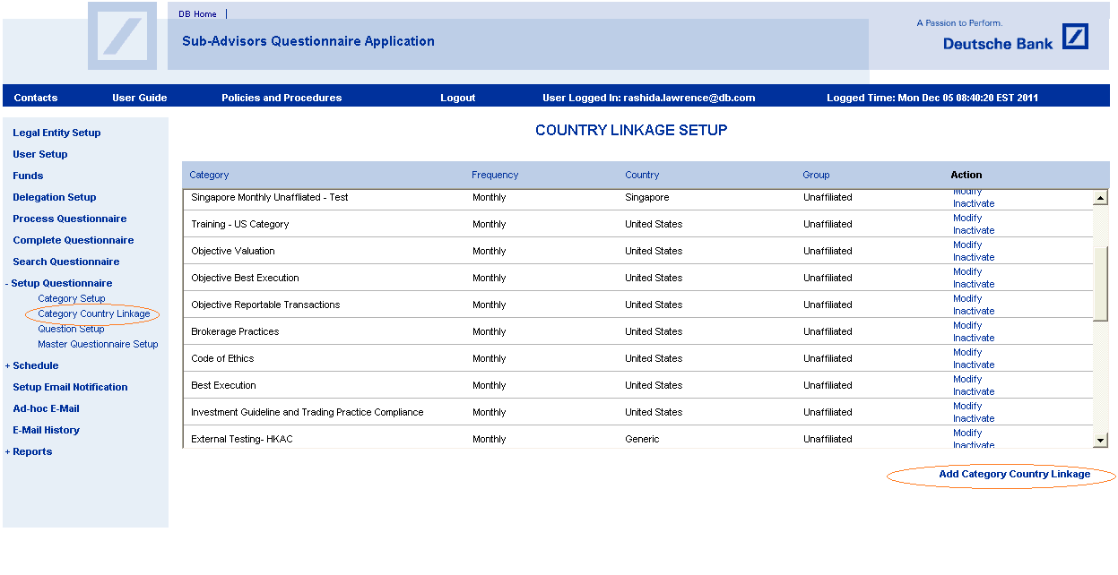
Category Country Linkage (Contd.)

Slide 19
Category Country Linkage (Contd.)
In Add country Linkage screen, a Super/Global user can map from the available drop down list of Frequency to Category to Country and Type to form a unique relationship.
Category Country linkage details are updated in SA_Category_Country_Linkage table on click of save button
If a user tries to create/add a similar combination that pre-exists in the system for the combination of Frequency, Category, Country and Sub Advisor type, a user alert message is displayed .
During modification, if the existing relationship changed will not impact historical questionnaires template created.
On click of cancel button, user will be directed to main page Country Linkage Setup.
An Audit trail table will be maintained for all historical changes done to the country Category setup table.

Slide 20
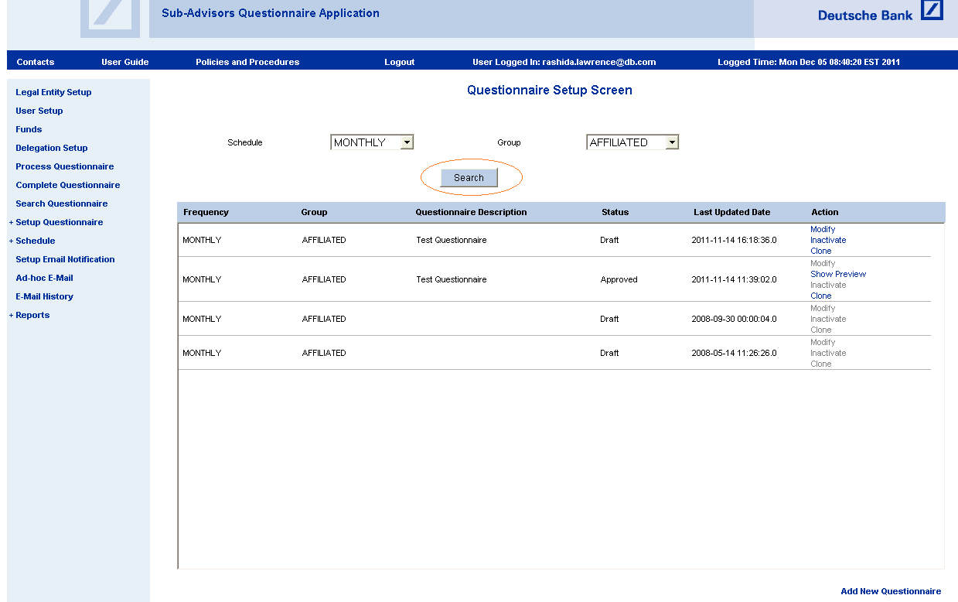
Master Questionnaire Setup
Global super user/super user can create 6 possible questionnaire templates.
i.e. for each Frequency and Sub advisor type.
The system will take latest approved Questionnaire template during questionnaire generation.
    Questionnaires can have,
      GENERIC questions that apply to all countries and COUNTRY SPECIFIC questions. e.g. Quarterly Questionnaire from a US delegator will have generic questions plus questions applicable only to US

Slide 21
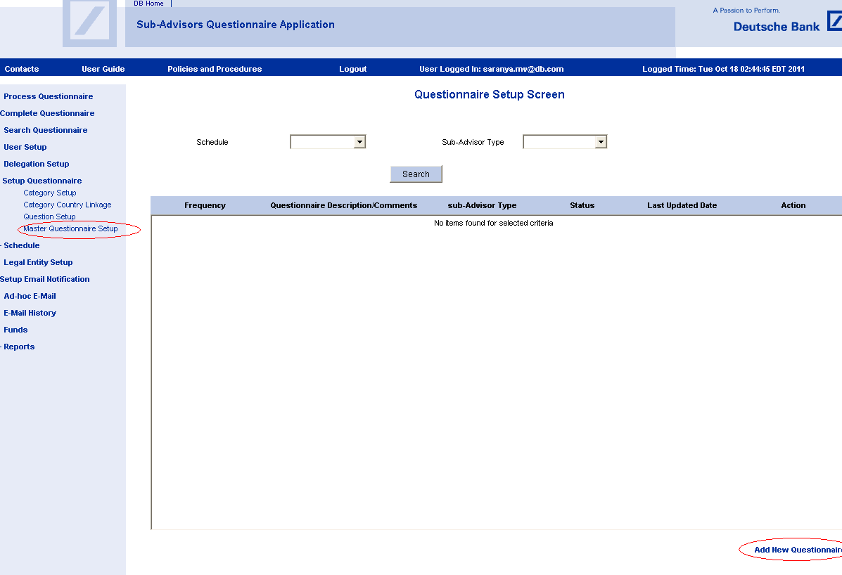
Master Questionnaire Setup (Contd.)
To create a questionnaire template
1.Click on the “Master Questionnaire Setup” link located under Setup Questionnaire from the left menu.
This will bring up the appropriate Questionnaire Setup screen.
2.Click on the Add New Questionnaire link to bring up the Questionnaire Add screen.

Slide 22
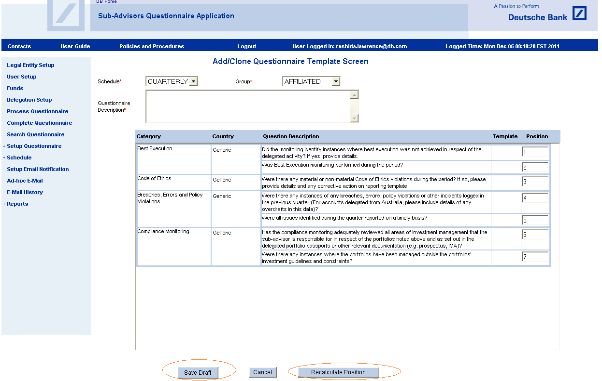
Master Questionnaire Setup (Contd.)

Slide 23
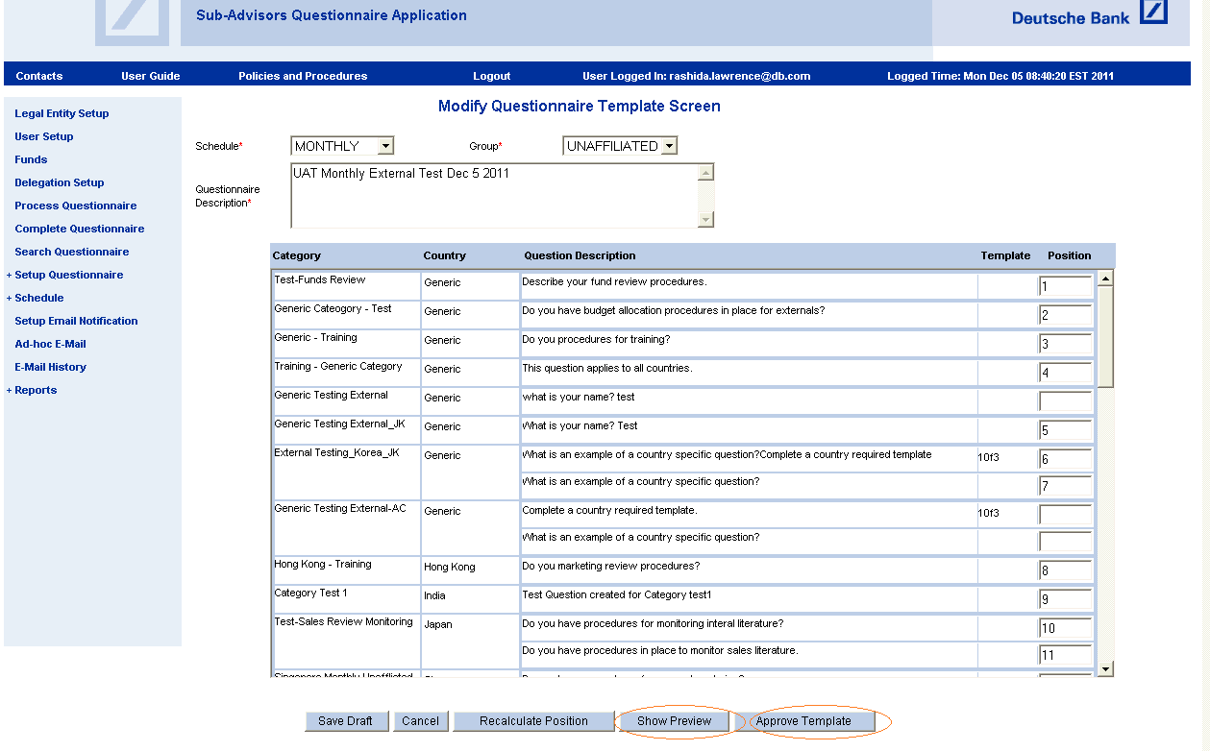
Master Questionnaire Setup (Contd.)
Choose the required Schedule and Sub-Advisor Type. The categories, Questions and Template mapped with the selected schedule and sub-advisor type in (Category Country Linkage) are displayed in the grid with default position numbers.
Remove the position numbers for excluding the questions from the template. The questions which don't have position numbers are excluded from the template.
Click on Recalculate position number. If the position numbers are not in order, ordered position numbers are assigned to the selected questions.
Click on Save Draft. If the Questionnaire has duplicate position numbers or incorrect position numbers it will throw an error message “The Questionnaire has missing position number. Please click on Recalculate position number before saving".
Click on "Draft Button" after selecting the required questions.

Slide 24
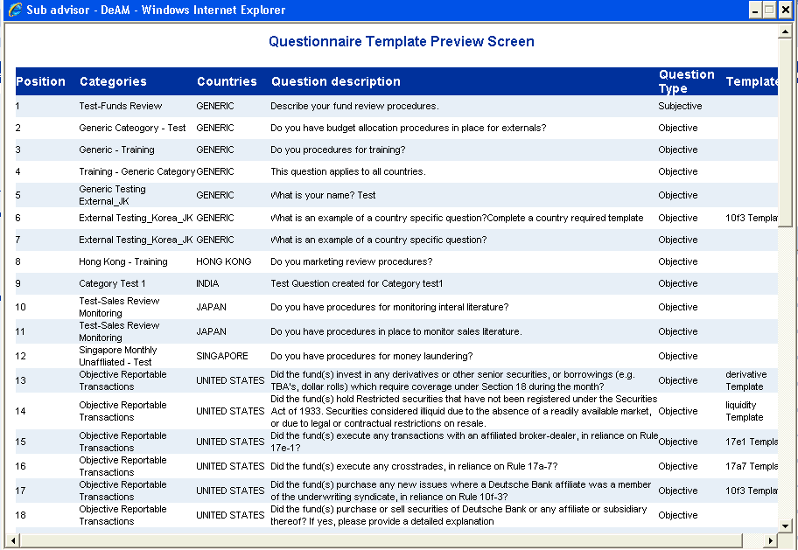
Master Questionnaire Setup (Contd.)
This action will create a questionnaire with a status of Saved and buttons "Show Preview" and "Approve" are displayed at the bottom of the Questions box.
Saved questionnaires can be reviewed and edited by the user from the Questionnaire Setup Screen.
User can preview the questionnaire using “Show Preview” button.
This screen shows the questions as they would appear on the questionnaire to the sub-advisor.

Slide 25
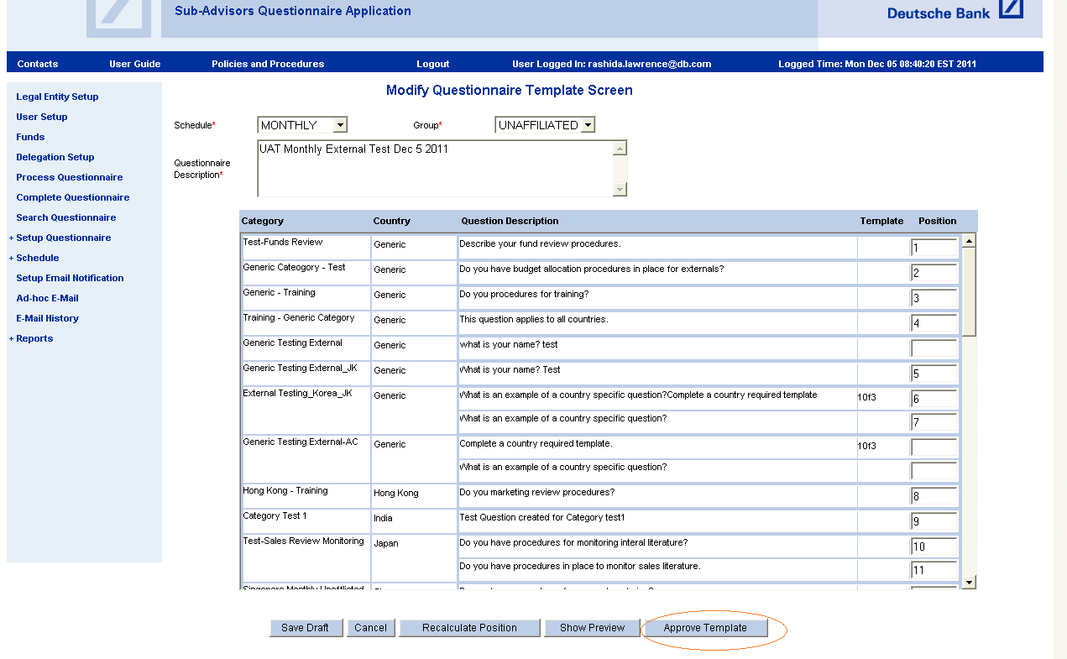
Master Questionnaire Setup (Contd.)

Slide 26
Master Questionnaire Setup (Contd.)
After the user has completed the process of assigning questions to a questionnaire and the questionnaire is ready for distribution.
Click on the Approve Template button.
A pop-up box will appear to confirm the approval of the questionnaire.
This action will change the status of the questionnaire to Approved and it will no longer be editable.

Slide 27
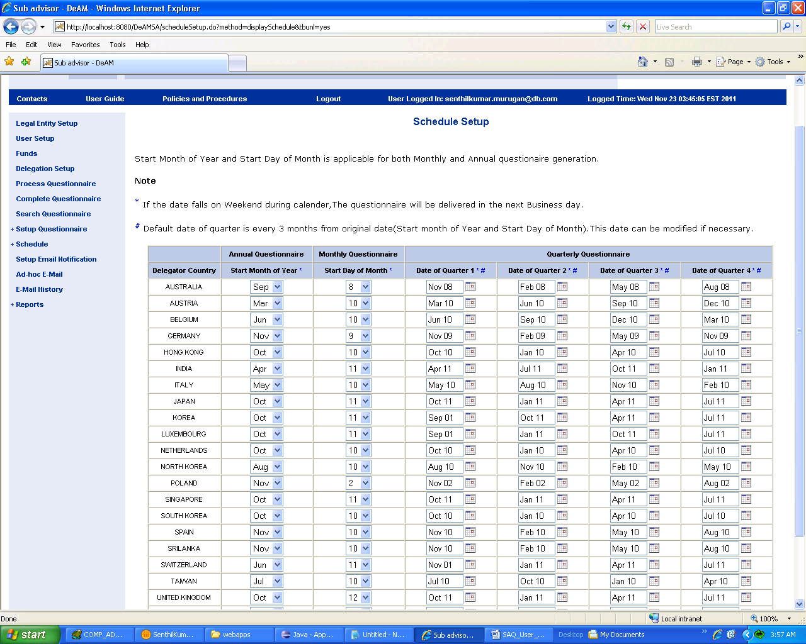
Schedule Setup

Slide 28
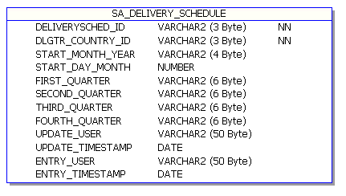
Schedule Setup (Contd.)

Slide 29
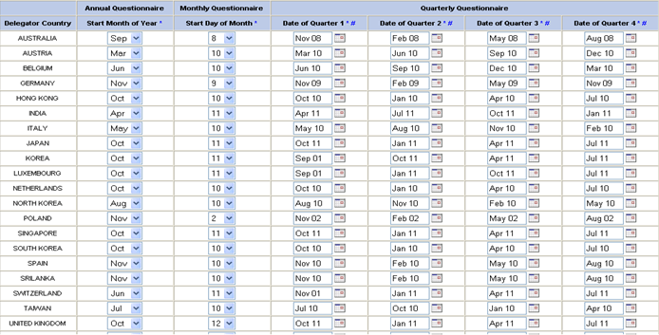
Flexible Questionnaire Generation

Slide 30
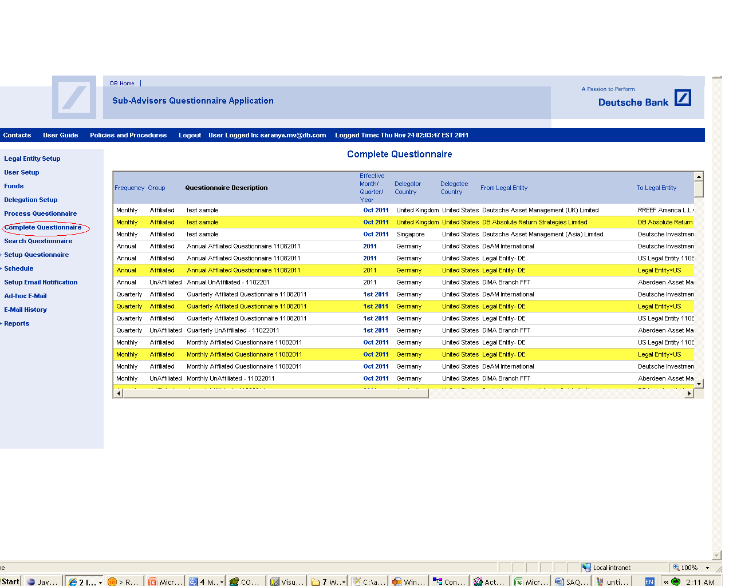
Complete Questionnaire

Slide 31
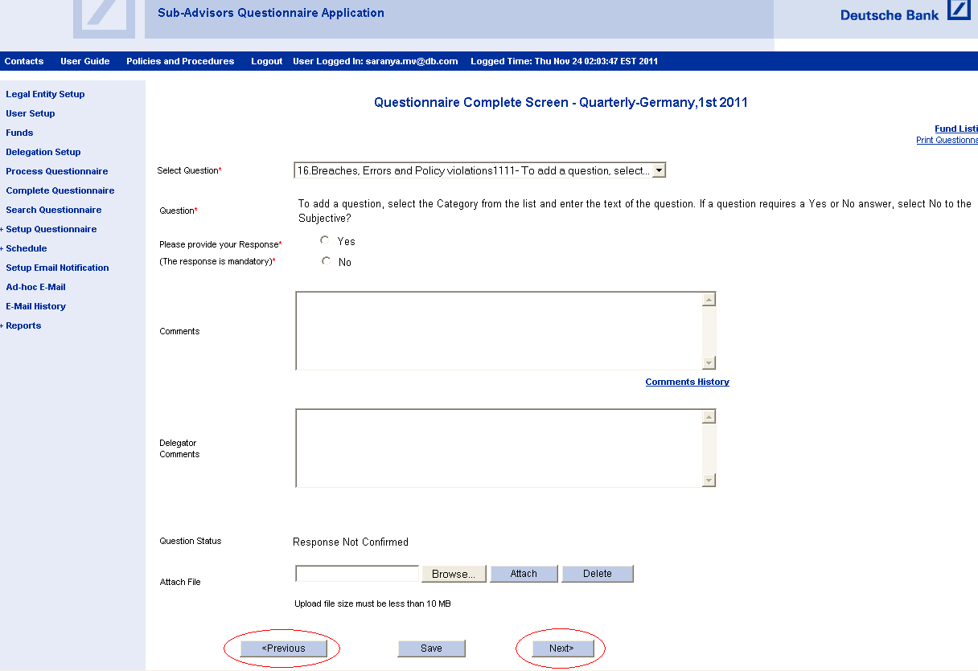
Complete Questionnaire (Contd.)
The new system has two new roles Regional Super user and Global Super user.
Global super user can view/edit all the Questionnaires. The Questionnaires to which Global super User is mapped as a delegate is displayed in yellow color.
Regional Super User can view all regional specific questionnaires.
Regional super user can edit the Questionnaire to which he is mapped as a delegate and the Questionnaires are displayed in yellow color.
The Regional super user can view/edit the Questionnaire to which he is a delegatee.
The Regional Super User can view the Regional specific Questionnaires in preview mode to which he/she is not a delegatee.
Delegatee can view/edit all the questionnaires which he has added as a Delegatee in Delegation Relationship.

Slide 32
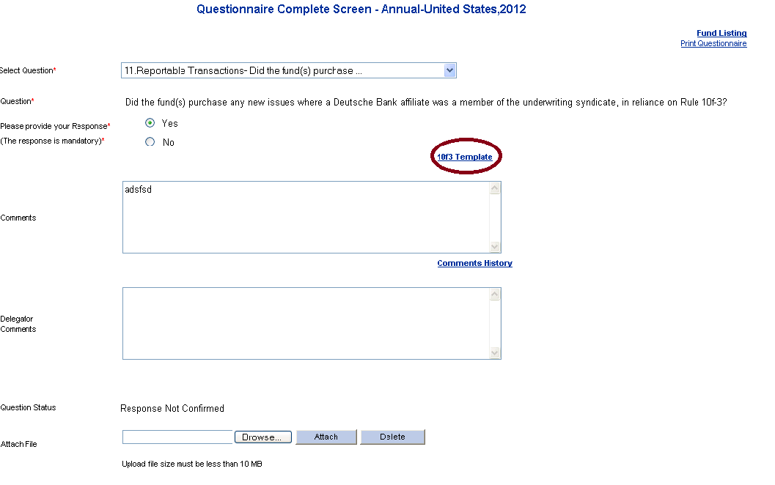
10F3 Template
user will need to complete it by clicking of the 10f-3 link next the appropriate question. This will bring up the 10f3 template below is the following is the screen shots.

Slide 33
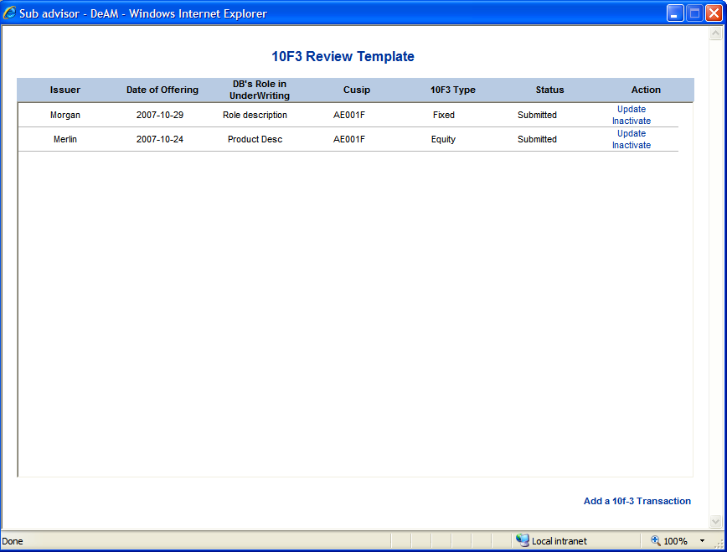
10F3 Template (Contd.)

Slide 34
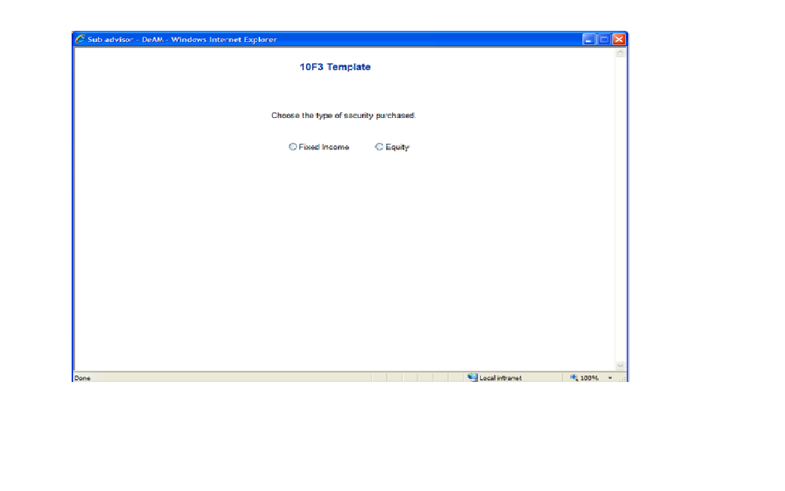
10F3 Template (Contd.)
The 10f3 template has two types transaction as Fixed Income 10f-3 and Equity 10f-3 template.
The below are the following screen shots.

Slide 35
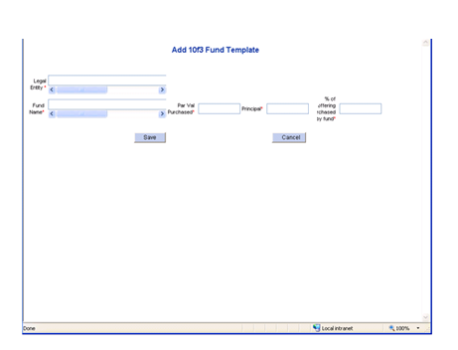
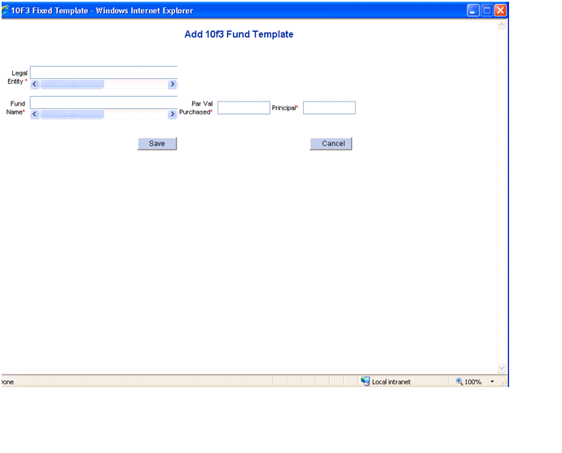
10F3 Template (Contd.)
On clicking ADD NEW 10F-3 FUND LINK the following screen will appears.
The fund screen gets differ for both affiliated and unaffiliated groups.
This screen is for affiliated group.

Slide 36
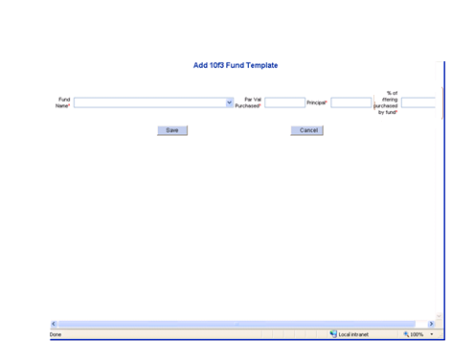
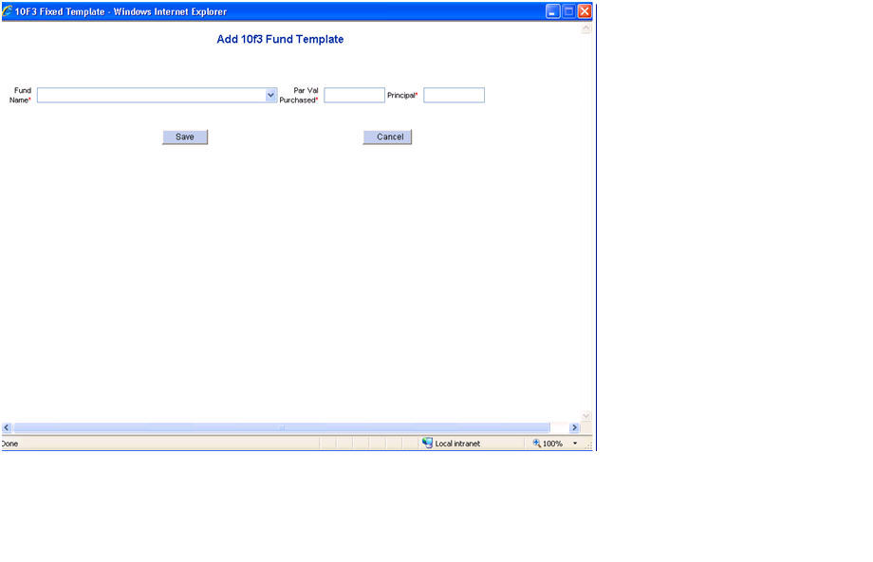
10F3 Template (Contd.)
This screen is for unaffiliated group.

Slide 37
10F3 Template (Contd.)
In this system we are providing more securities information in the 10F3 template (FIXED and EQUITY) in SAQ.
We have added Security Purchase , Comparable Security 1 and Comparable Security 2 with addition to new fields.
The fields for each type of security are in the table below, new added changes highlighted in blue.
The template screen for fixed income and equity will not differ for both affiliated and unaffiliated groups.
It can be accessed by all the roles GSU, RSU, Delegate's and Delegator’s.
We are maintaining template(FIXED & EQUITY) information on sa_template_10f3 table.

Slide 38
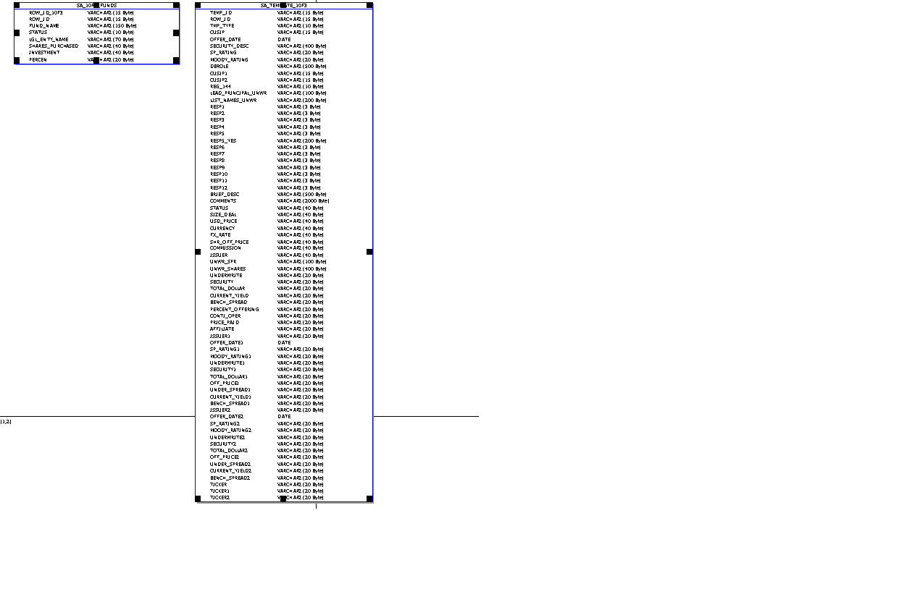
10F3 Template (Contd.)

Slide 39
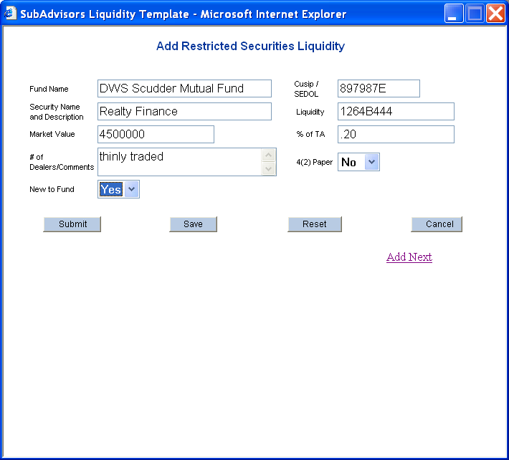
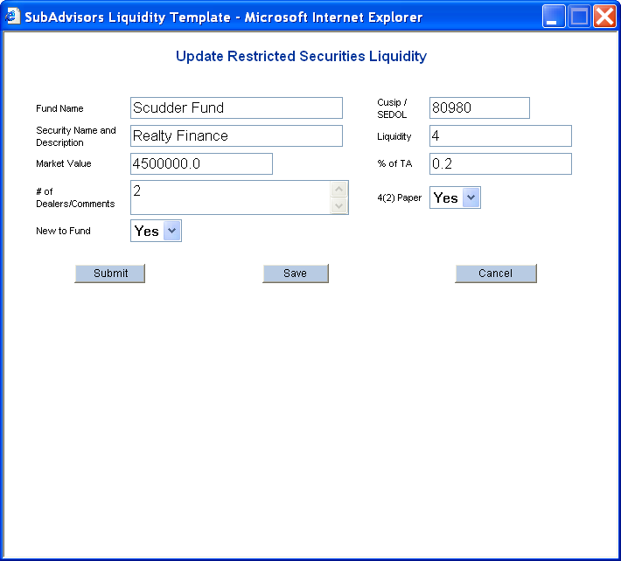
Add & Update Liquidity Template

Slide 40

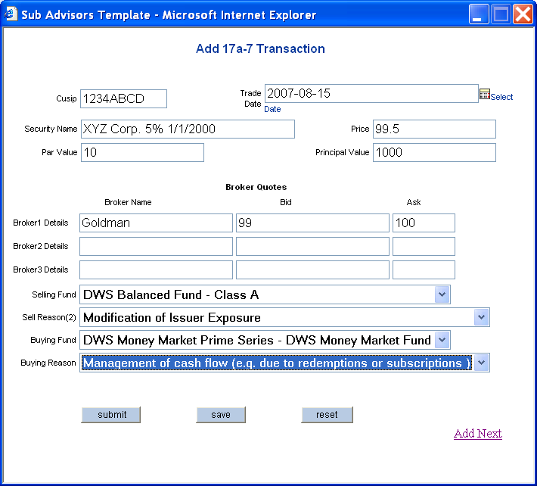
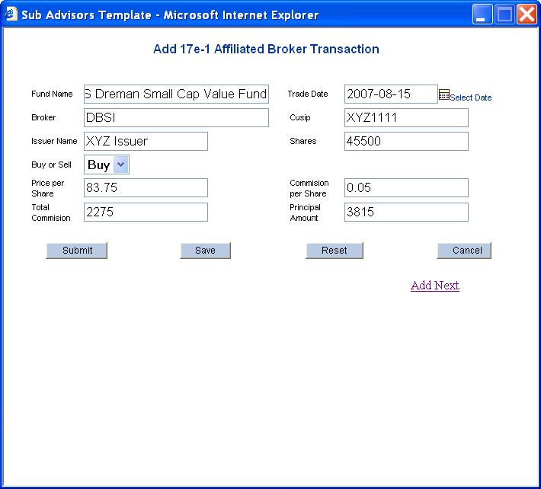
Adding 17e1 and 17 a-7

Slide 41
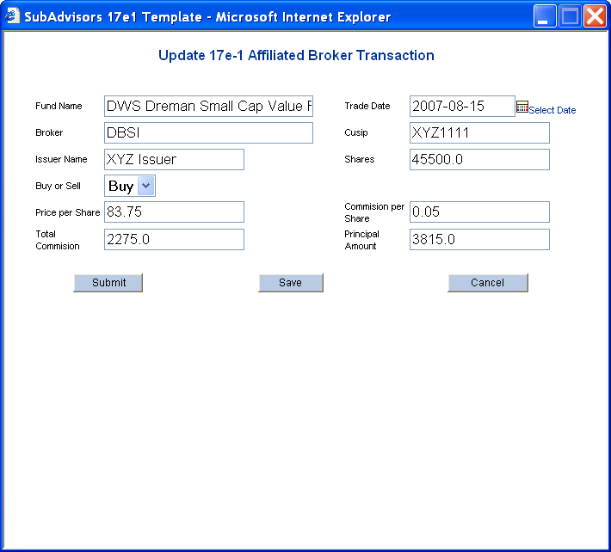
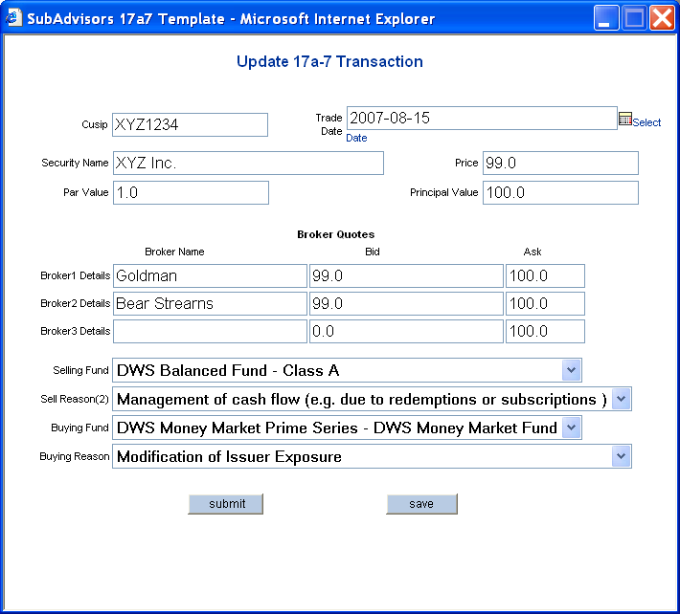
Updating 17 e-1 and 17 a-1 templates

Slide 42
Process questionnaire
The process questionnaire functionality allows a Compliance user to review the responses provided by sub-advisors.
The questionnaire displayed are based on logged in user role.
If current logged in user is global super user, the user will be able to review all questionnaires irrespective of the country/region
If current logged in user is regional super user, the user will be able to see his/her regional country questionnaires in read only mode.
If the current logged in user is delegator then the user will be able to review the questionnaires for which he/she is added as a compliance user or delegator.
For both RSU and GSU, the questionnaires for which the logged in user is added as complaince user, will be highlighted in yellow.
Approved questionnaires will not be listed in process questionnaire screen and can be tracked or previewed from search questionnaire screen by giving the valid search criteria.

Slide 43
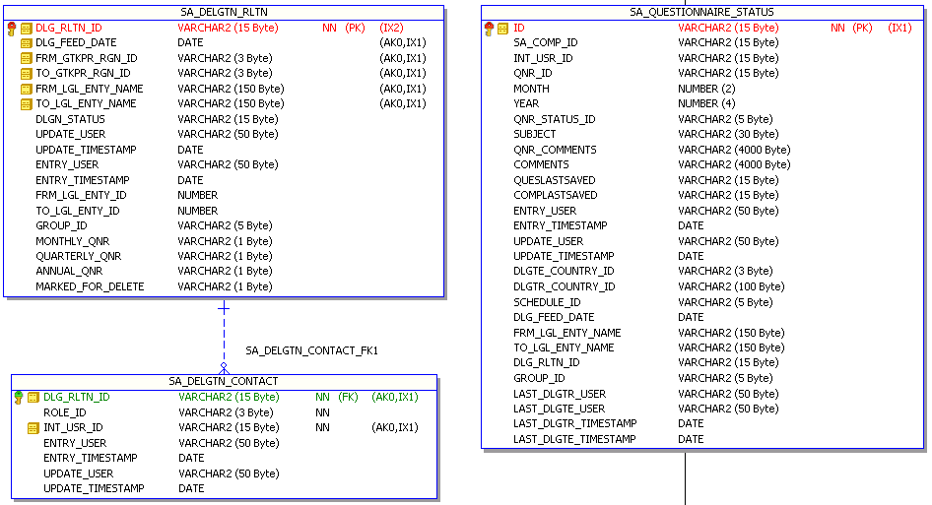
Process questionnaire (Contd.)

Slide 44
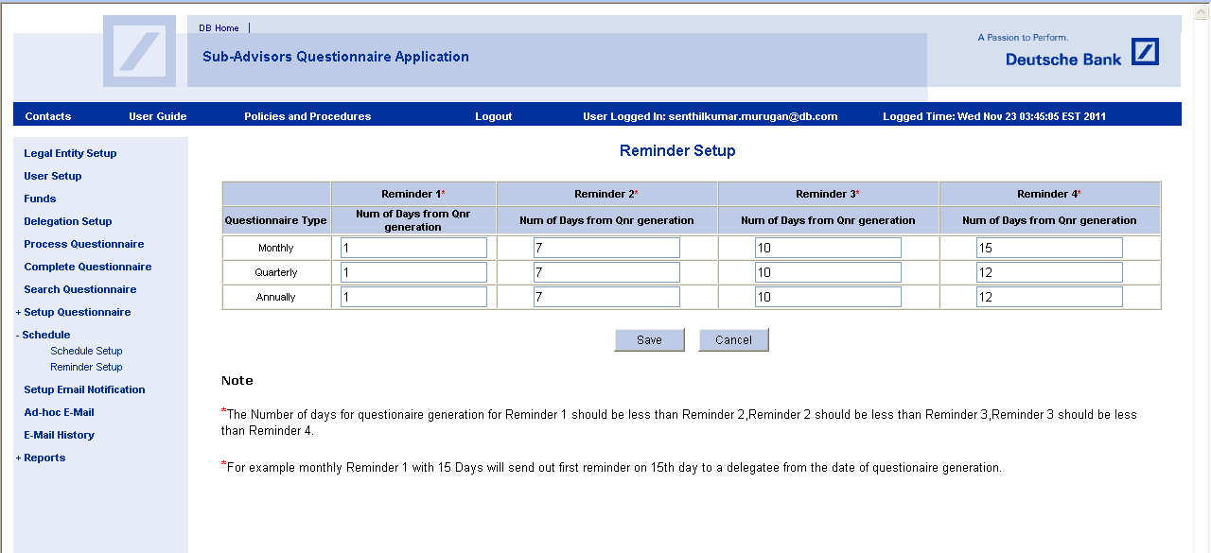
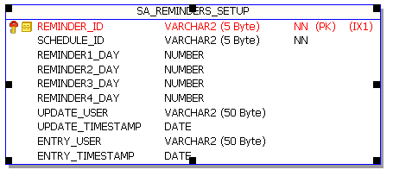
Reminder Setup

Slide 45


Slide 46


